Slide 1
Engineering A* for Autonomous Path Planning of Tracked Vehicle
Project Guide
Mr. Shibumon Alampata, Scientist – F
Geographical Information Systems Division,
Centre for Artificial Intelligence and Robotics,
Defence Research and Development Organization.
Presented by
Mullainathan V H - 22R435
Sivatmiga T N - 22R447
Department of Robotics and Automation,
PSG College of Technology.

Slide 2
INTRODUCTION
Project Scope:
Optimizing path planning approaches for autonomous tracked tanker vehicle movement across multiple terrains.
Objectives:
Understand and identify permafrost zones in terrain of strategic importance.
Avoidance of hazardous or thaw-prone areas in vehicle path planning.
Implement terrain-aware A* for mission-critical autonomous navigation in the Himalayas.
Why A* Algorithm?
A widely used graph-based search algorithm in path planning.
Requires optimization for real-world constraints like terrain elevation, environmental factors, and GIS data integration.

Slide 3
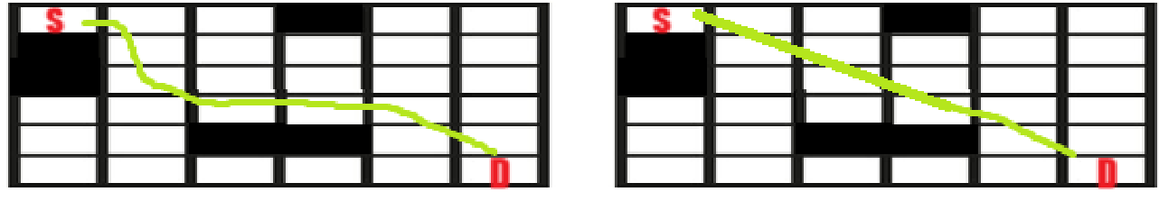
CHALLENGES
Key Challenges:
1. Path Planning Issues in GIS-based Systems - A* struggles with real-world elevation variations, obstacles, and various terrain constraints. The main issue faced is as shown in the figure below:
Observed planning Required planning

Slide 4
CHALLENGES
Key Challenges:
2. Developing a Permafrost Map - Autonomous navigation in cold regions requires understanding permafrost risks that are to be avoided. Key risks include:
Unstable Ground Conditions – Risk of sinking or immobilization
Thermokarst Formation – Depressions and cracks in terrain
Surface Strength Variability – Sudden loss of ground support
Ice Accumulation & Slippage – Reduced traction and control
Cold-Induced Failures – Mechanical and electronic malfunctions
Vehicle Heat Impact – Local permafrost thawing risk
Sensor Reliability Issues – Obstructed LiDAR and cameras
Waterlogged Terrain – High resistance and energy usage
Path Planning Challenges – Constant terrain changes

Slide 5
PERMAFROST MAPPING
Region of Interest & Time Period (INDIA):
Coordinates: 75.5°E to 80.5°E, 36.5°N to 28.5°N
Key Locations in India: Leh, Kargil, Diskit, Hunder, Turtuk, Panamik, Sumur, Alchi, Likir, Basgo, Nimoo, Lamayuru, Saspol, Uleytokpo, Rizong
Extended Plains: Chandigarh, Ambala, Ludhiana, Patiala, Amritsar, Shimla, Solan, Dehradun, Meerut, Saharanpur, etc.
Time Period: January 2020 to December 2023
Permafrost Probability Model
Derived a weighted equation from literature (Raza et al., Overduin et al.)
Formula: X = Wm * Rm + Wp * Rp + Wa * Ra + Ws * Rs; PE = X * GSC
Input factors:
MAAT (BMAT from MODIS LST)
Slope & Aspect (from SRTM DEM)
PISR (Potential Solar Radiation)
Ground Surface Cover (NDVI, NDSI)
Normalized ratings and fixed weights (Wm=0.4, Wp=0.2, Wa=0.2, Ws=0.2)
Weights:
Wₘ – Weight for MAAT / BMAT (here, 0.4)
Wₚ – Weight for PISR (0.2)
Wₐ – Weight for Aspect (0.2)
Wₛ – Weight for Slope (0.2)
Ratings (normalized indices or reclassified scores):
Rₘ – Rating based on MAAT (from MODIS LST)
Rₚ – Rating based on PISR (from solar radiation models)
Rₐ – Rating based on aspect (north-facing vs. south-facing)
Rₛ – Rating based on slope steepness
Ground Surface Cover Factor: GSC – Ground Surface Cover coefficient (derived from NDVI, NDSI, land cover classification). It adjusts the combined score to reflect the insulating or exposing effect of vegetation/snow/rock types.
PE: Permafrost Estimation (PE) – Final probabilistic score indicating presence/absence likelihood of permafrost.

Slide 6
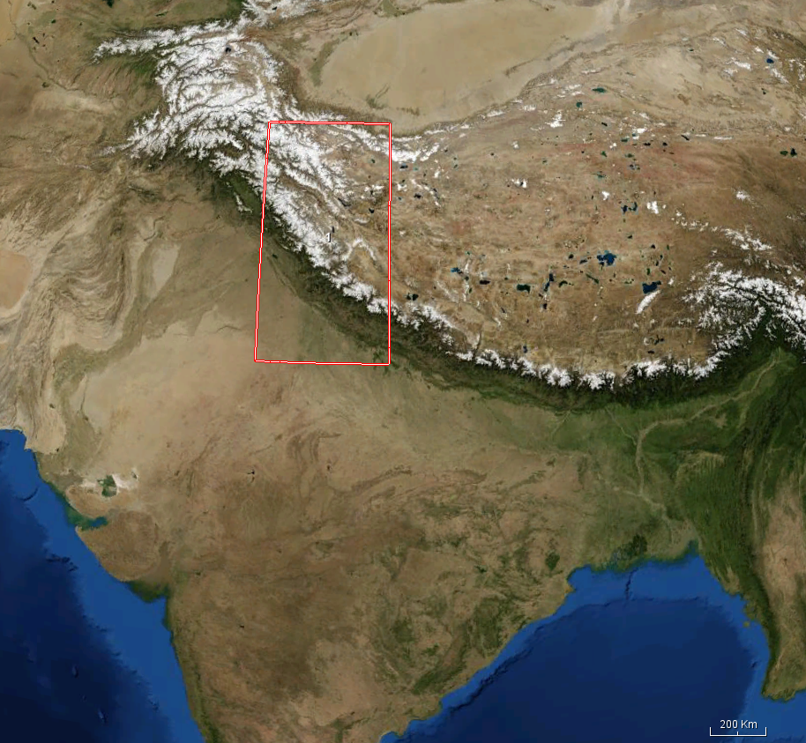
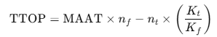
PERMAFROST MAPPING
Step-by-Step Functionality:
1. Load Input Data
Reads raster files: DEM, LST, NDVI, Slope, NDSI, Soil properties, FDD, and TDD.
Resamples them to a common spatial resolution and shape using the DEM as reference.
2. Clean FDD and TDD
Ensures all invalid values (NaN, inf, negative) are handled.
Resizes if shapes don’t match.
3. Estimate Soil Thermal Properties
Computes frozen (Kf) and thawed (Kt) thermal conductivity using clay and bulk density.
Clips them to realistic physical ranges.
4. Estimate n-factors
Surface energy balance correction using NDVI and NDSI:
nf for freezing
nt for thawing
5. Compute TTOP (Temperature at the Top of Permafrost): Where MAAT is approximated from LST.

Slide 7
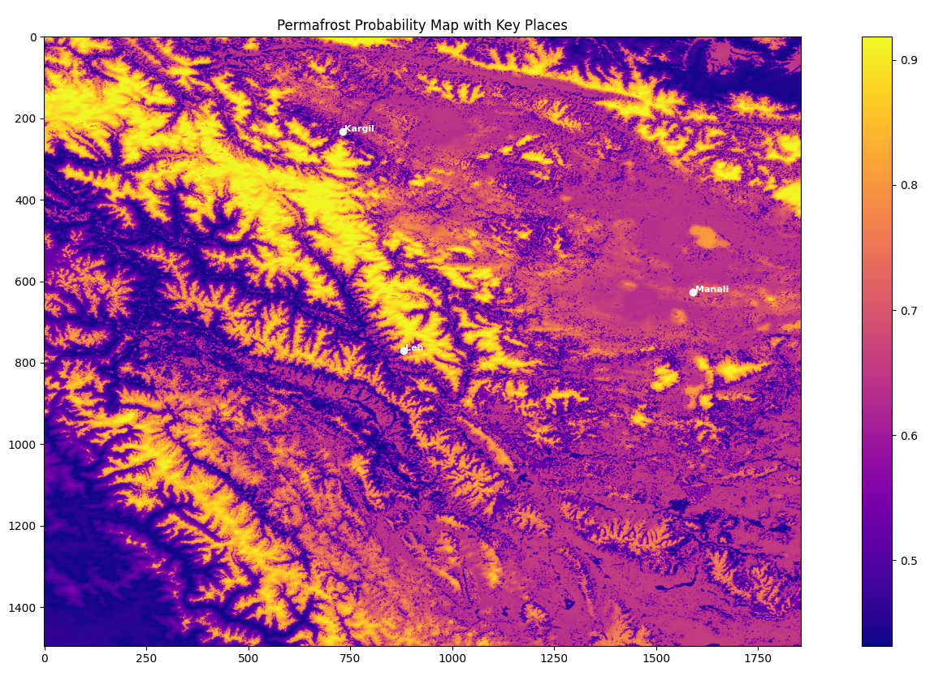
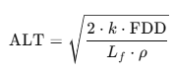
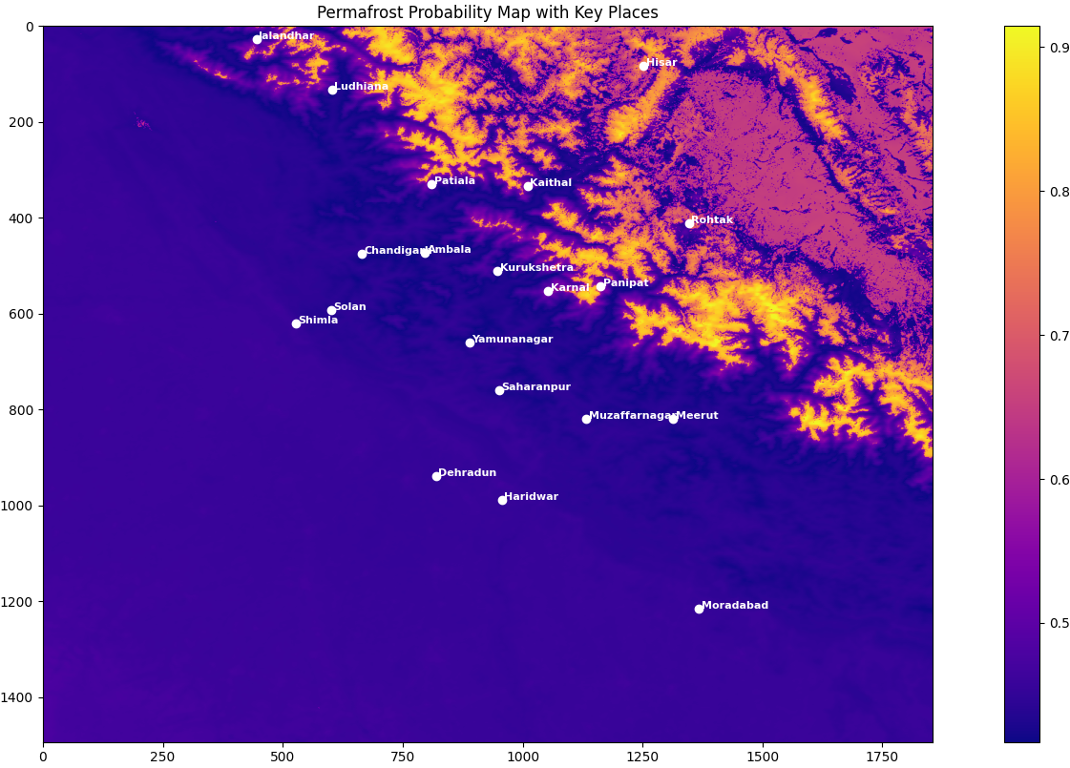
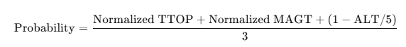
PERMAFROST MAPPING
6. Compute ALT (Active Layer Thickness)
Where:
k = average thermal conductivity
Lf = latent heat of fusion of water
ρ = soil density
7. Classify High Confidence Permafrost Zones: Zones where ALT < 1.5 m are marked as permafrost.
8. Compute Final Permafrost Probability:
9. Export Outputs
ALT.tif: Estimated active layer thickness
Permafrost_Probability.tif: Final combined permafrost probability map
PermafrostZone_ALT_lt_1_5.tif: Binary mask of high-confidence permafrost

Slide 8
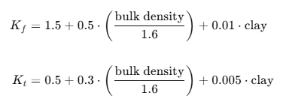
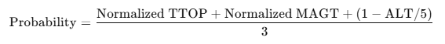
PERMAFROST MAPPING
References:
1. TTOP (Temperature at the Top of Permafrost) Equation
Smith and Riseborough (2002). “Climate and the limits of permafrost: a zonal analysis.” Permafrost and Periglacial Processes.
This equation relates Mean Annual Air Temperature (MAAT), soil thermal conductivities, and n-factors to estimate the ttop.
2. Active Layer Thickness (ALT) Equation
Lunardini (1981). “Heat Transfer in Cold Climates.”
This is based on the Stefan equation, which estimates the depth of seasonal thaw in frozen ground using:
Thermal conductivity k
Freeze Degree Days (FDD)
Soil density ρ
Latent heat of fusion L_f
3. Thermal Conductivity Estimation (Kf, Kt)
Modified from empirical formulations by Zhang et al. (2008) and Riseborough et al. (2008)
These equations approximate frozen and thawed soil conductivity using bulk density and clay content, which are key factors influencing soil thermal behavior.
4. n-Factor Estimation
nf = np.where(NDVI > 0.2, 0.7, 0.5)
nt = np.where(NDSI > 0.3, 0.6, 0.9)
Klene et al. (2001); Zhang et al. (1997)
Empirical assignment of freezing (nf) and thawing (nt) n-factors based on vegetation (NDVI) and snow (NDSI). These affect the surface energy balance.
5. MAGT Proxy Equation
Coefficients used: α = -1.5, β = -2.2, δ = -0.5, ε = -0.2, C = 5.0
Derived from methods in:
Obu et al. (2019), Northern Hemisphere permafrost map
Kumar et al. (2021), Permafrost modeling in the Indian Himalayas
This equation combines normalized environmental variables to approximate MAGT where borehole data is unavailable.
6. Permafrost Probability
Composite logic adapted from Obu et al. (2019) and Raza Khan et al. (2021) for probability mapping.
It integrates thermal (TTOP, MAGT) and physical (ALT) indicators for robust classifications

Slide 9
PERMAFROST MAPPING
Color | Interpretation
Bright Yellow/White (0.9+) | Very high permafrost probability (most likely frozen all year)
Orange to Purple (~0.6 – 0.8) | Moderate to high likelihood – likely continuous or discontinuous permafrost
Dark Purple (< 0.5) | Low or no permafrost – could be seasonally thawing or warm terrain

Slide 10
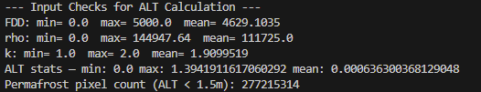
PERMAFROST MAPPING
Observation:
Most terrain around Leh and Kargil is bright yellow, meaning high permafrost potential.
Manali region shows relatively lower intensity (orange–purple), indicating transitional or patchy permafrost.
Parameter | Explanation | Meaning
FDD | Freeze Degree Days | Min = 0.0, Max = 5000.0, Mean = 4629.1 → shows the total freezing thermal load over the year. A high mean suggests long and cold winters, suitable for permafrost formation.
rho | Soil density (kg/m³) | Mean = 111725 → This seems 100x higher than typical (~1300–1600 kg/m³), likely because bulk_density was already in kg/m³ but was multiplied again. This high density artificially reduces ALT thickness.
k | Thermal conductivity (W/mK) | Range is realistic: 1.0–2.0 W/mK → indicates moderate to high conductivity depending on soil type.
ALT stats | Active Layer Thickness (m) | Max = 1.39 m, Mean = 0.0006 m → The extremely low mean means most regions are predicted to be near-frozen year-round, i.e., likely permafrost.
Permafrost pixel count | Number of pixels where ALT < 1.5 m | 277,215,314 → Almost all pixels in your study area are considered permafrost under this condition.

Slide 11
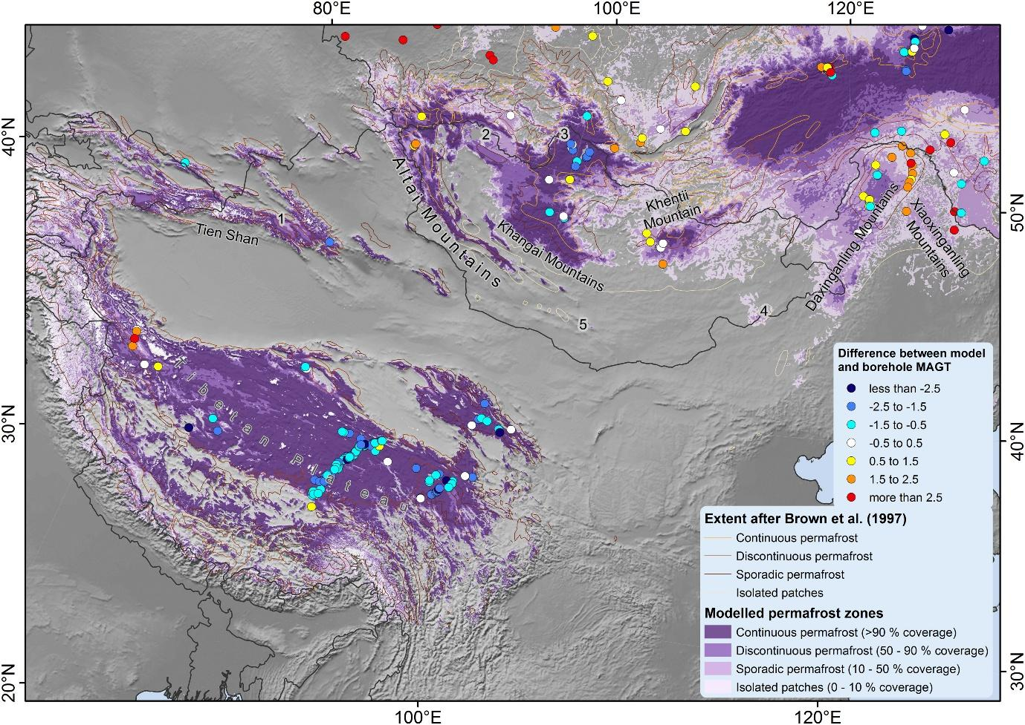
PERMAFROST MAPPING
Ground Truth
Output

Slide 12
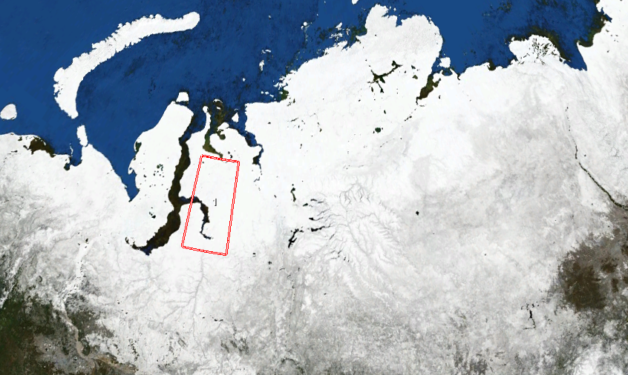
PERMAFROST MAPPING
Region of Interest & Time Period (RUSSIA):
Coordinates: 75.5°E to 80.5°E, 67.0°N to 71.0°N
Key Locations in India: Salekhard, Labytnangi, Nadym, Novy Urengoy, Noyabrsk, Tazovsky, Antipayuta, Gyda, Yamburg, Sabetta
Time Period: January 2020 to December 2023

Slide 13
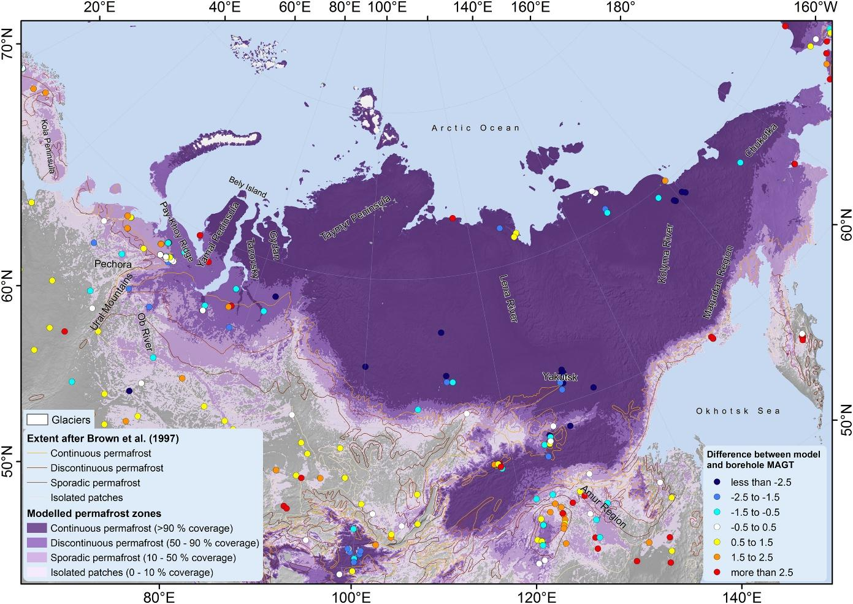
PERMAFROST MAPPING
Ground Truth

Slide 14
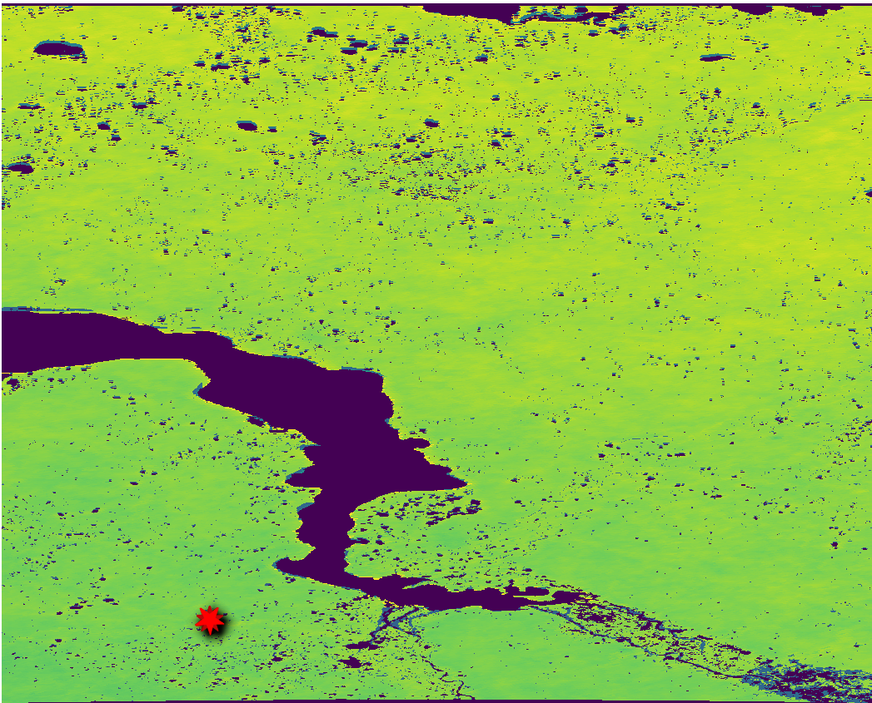
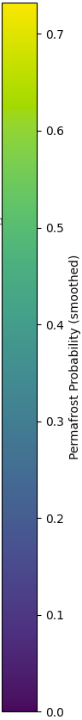

PERMAFROST MAPPING
Output:
--- Input Checks for ALT Calculation ---
FDD: min= 0.0 max= 5000.0 mean= 4556.725
rho: min= 0.0 max= 139894.02 mean= 105376.97
k: min= 1.0 max= 2.0 mean= 1.8855983
ALT stats — min: 0.0 max: 2.54236106189146 mean: 0.0006644549458326142
Permafrost pixel count (ALT < 1.5m): 276547365
Borehole Data Available

Slide 15
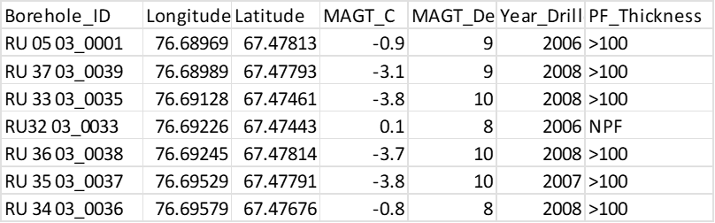
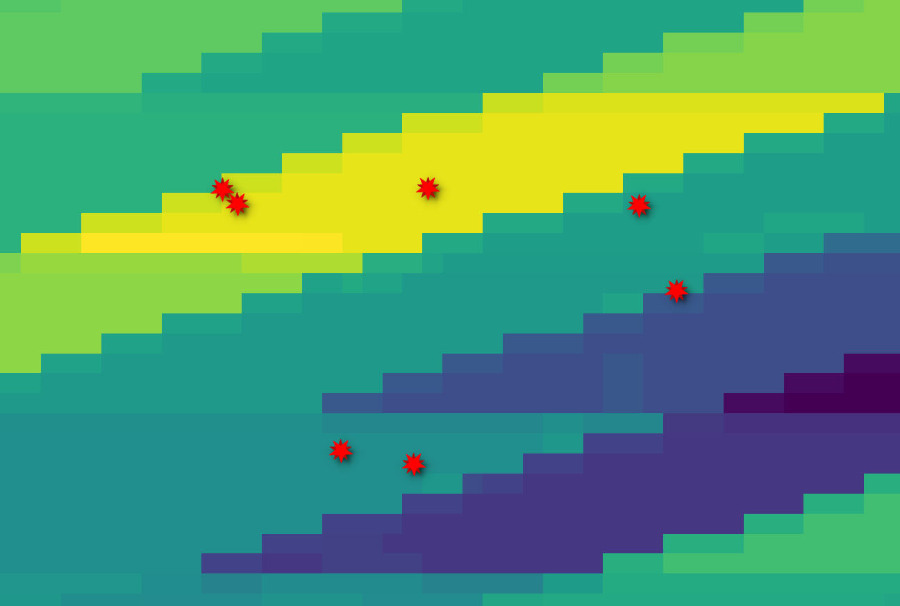

Slide 16
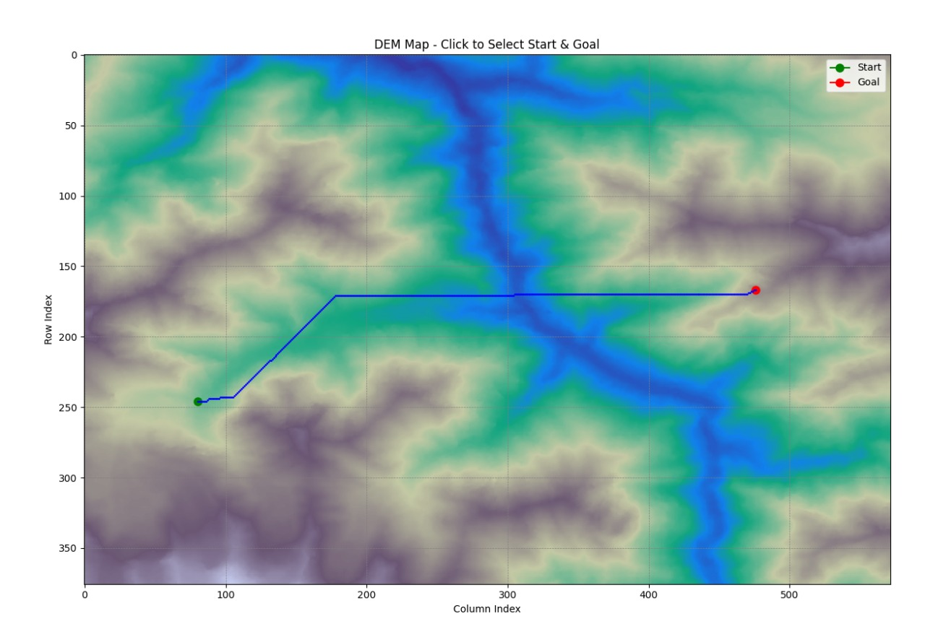
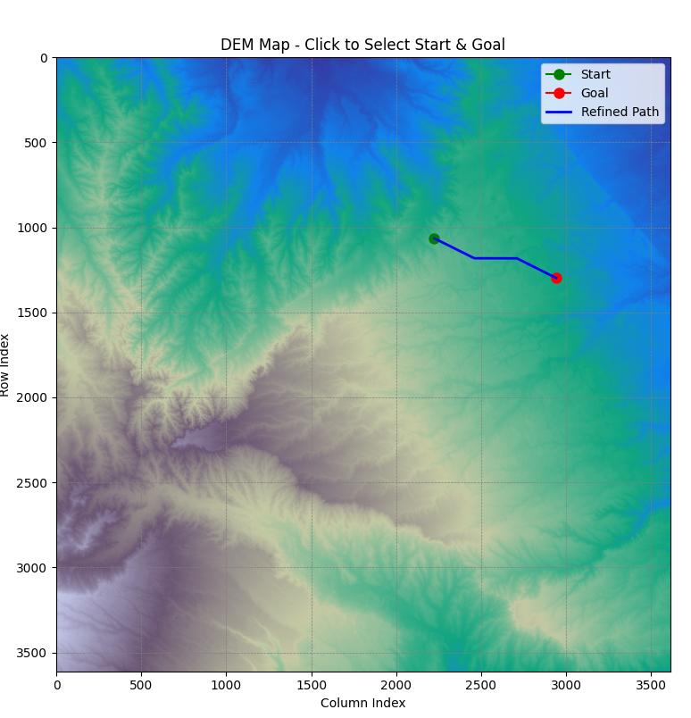
A* PROBLEM MANIFESTATION
Simple A* over DEM without any Constraints
Reasons:
Raster Grid Constraints
The DEM is a discrete grid, not a continuous surface.
A* must move from pixel to pixel — either horizontally, vertically, or diagonally.
So even the "straightest" diagonal will be an approximation (like a stair-step pattern).
8-Connected Grid Search
The directions allowed are limited to:
4 cardinal (N, S, E, W)
4 diagonal (NE, NW, SE, SW)
There’s no interpolation between directions, so the path is forced to switch between these options to approximate diagonality.
Uniform Cost:
All open cells = same cost.
Path can’t distinguish truly free space from edges, causing detours.
Binary Slope Filter:
Slope is pass/fail, no extra penalty for steep areas.
Encourages hugging if edges remain just under slope cutoff.

Slide 17
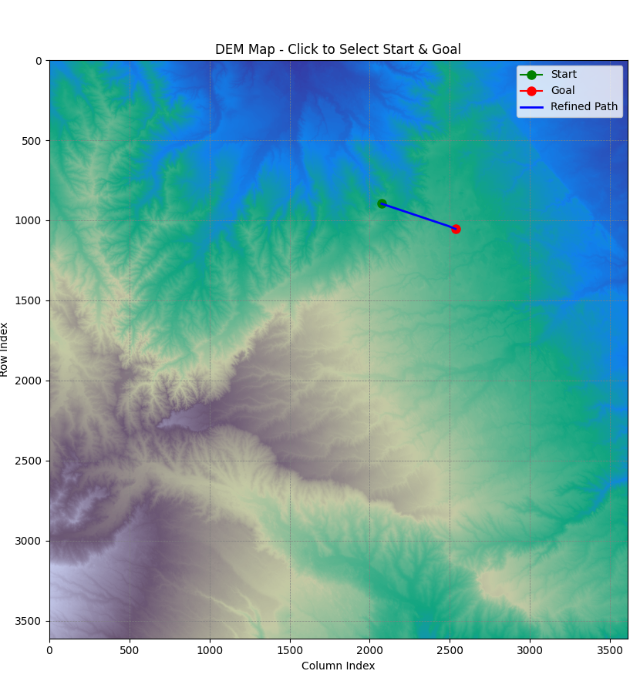
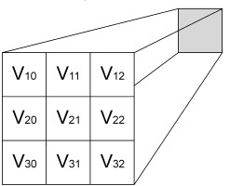
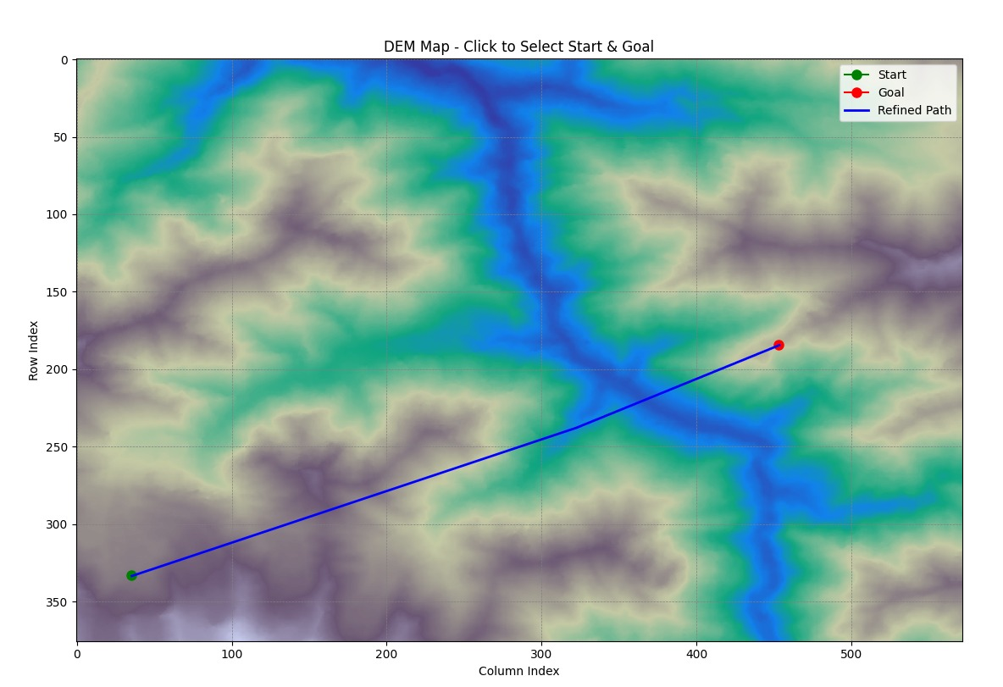
A* PROBLEM RECTIFICATION
Simple A* with Pixel Resampling over DEM without any Constraints
A Star with Grid Resampling
(Creates Sub pixels inside each pixel)
def heuristic(a, b):
return np.hypot(a[0] - b[0], a[1] - b[1])
Euclidean distance between two points, used as the heuristic estimate.
tentative_g = g_score[current] + np.hypot(dx, dy)
if neighbor not in g_score or tentative_g < g_score[neighbor]:
came_from[neighbor] = current
g_score[neighbor] = tentative_g
f_score = tentative_g + heuristic(neighbor, goal)
heapq.heappush(open_set, (f_score, neighbor))
tentative_g: cost from start to this neighbor via current.
If this path is better than previously known, update:
came_from: record that current led to neighbor.
g_score: store updated cost.
Compute f_score and add neighbor to open_set
substeps = 4 directions = [(dx / substeps, dy / substeps)
for dx in range(-substeps, substeps + 1)
for dy in range(-substeps, substeps + 1)
if not (dx == 0 and dy == 0)]
It considers movements like ±0.25, ±0.5, … up to ±1 in all 8 directions.

Slide 18
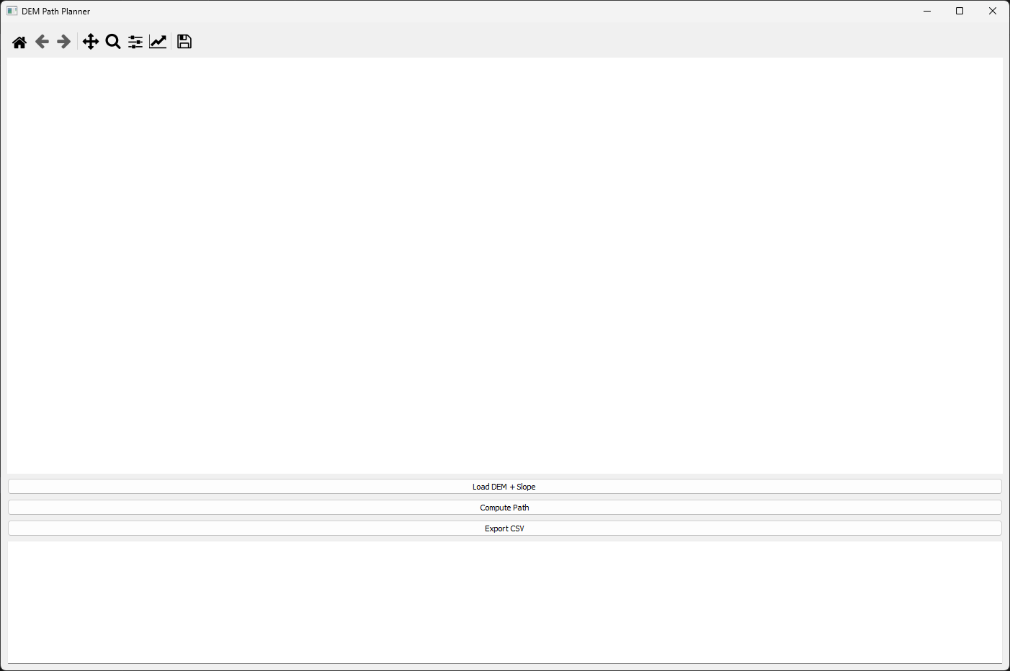
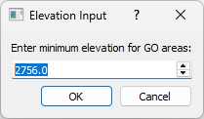
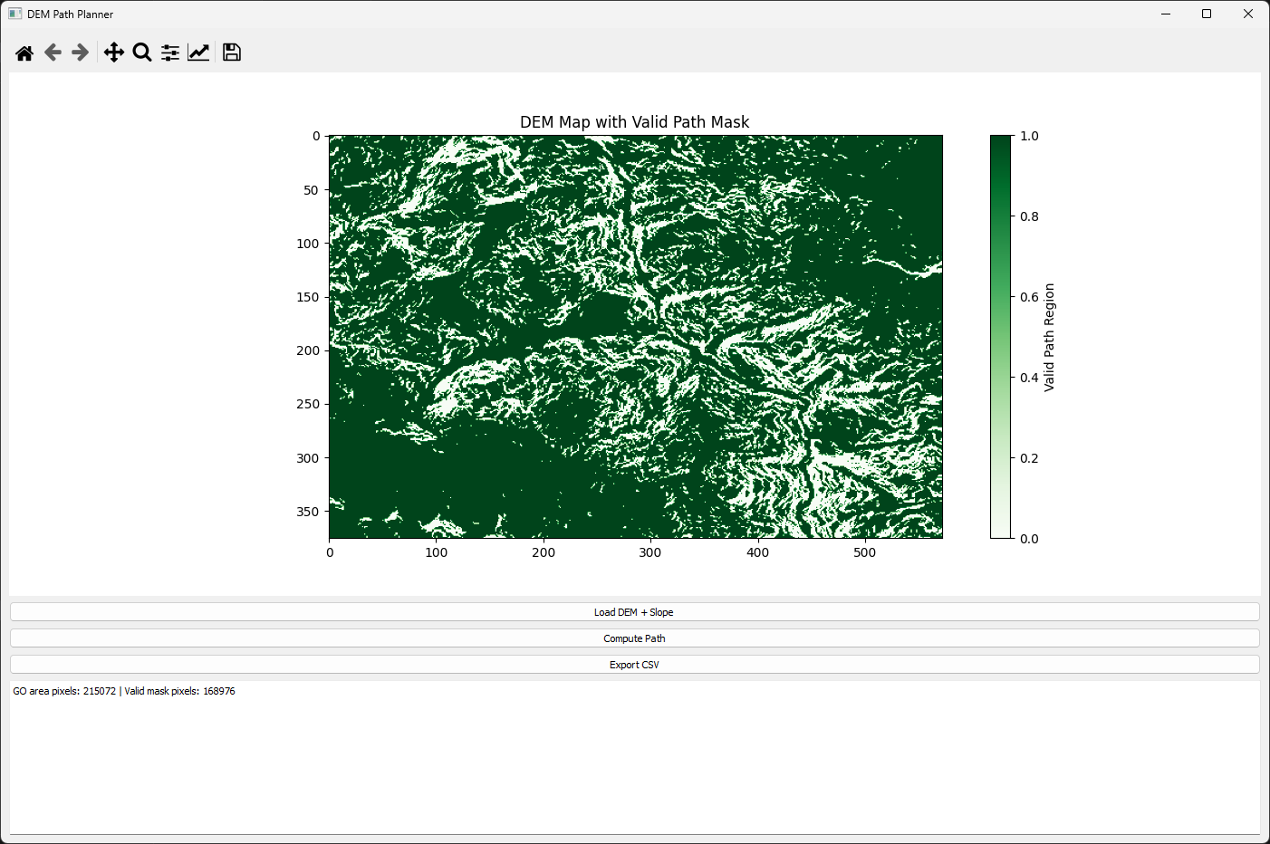
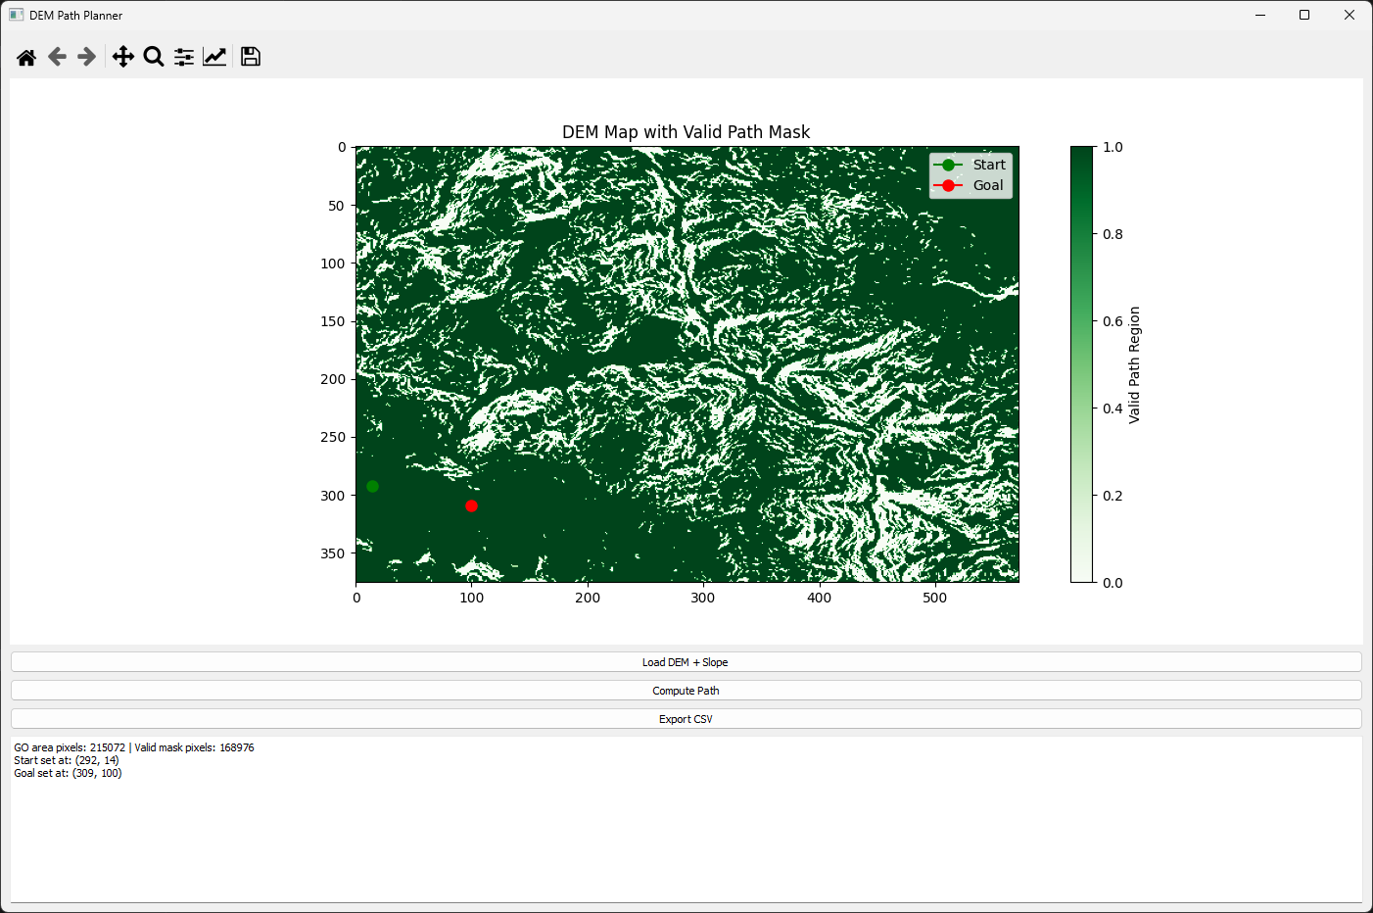
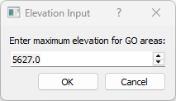
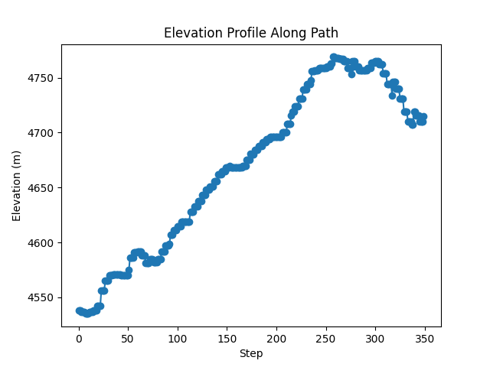
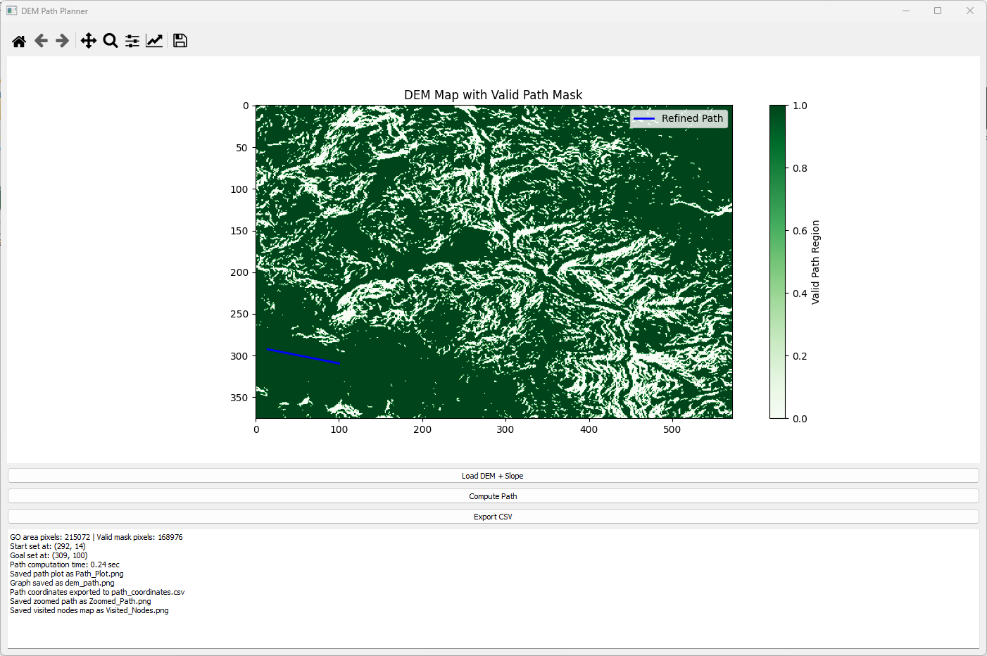
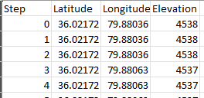
A* PROBLEM RECTIFICATION
DEM-Based Path Planning GUI Using Elevation and Slope-Constrained Subpixel A* Search
This GUI-based application performs elevation-aware path planning using A* algorithm over a Digital Elevation Model (DEM) and slope raster input. The DEM provides elevation values, while slope is used to eliminate unsafe traversal areas (> 35°). User inputs the minimum and maximum elevation values to define the GO (go-operable) area. The system creates a binary mask where pixels are marked valid if elevation and slope conditions are met. The GO area is rendered on the map. Users can click to select start and goal points only within valid terrain. The GUI runs a subpixel A* algorithm (32-directional search, 4 substeps) over the valid mask. The computed path avoids steep slopes and elevation-violating regions.
Step 1- Load Raster Data
Step 2-Define Elevation Range
Step 3-Visualize Valid Terrain
Step 4-A* Path Planning Execution
Output
path_coordinates.csv
Elevation along the planned path
Planned Path

Slide 19
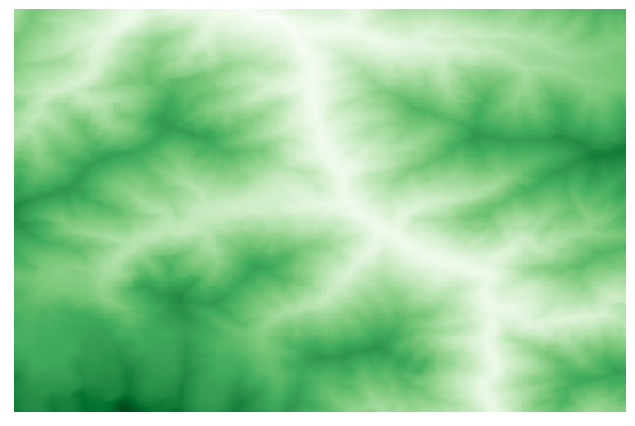
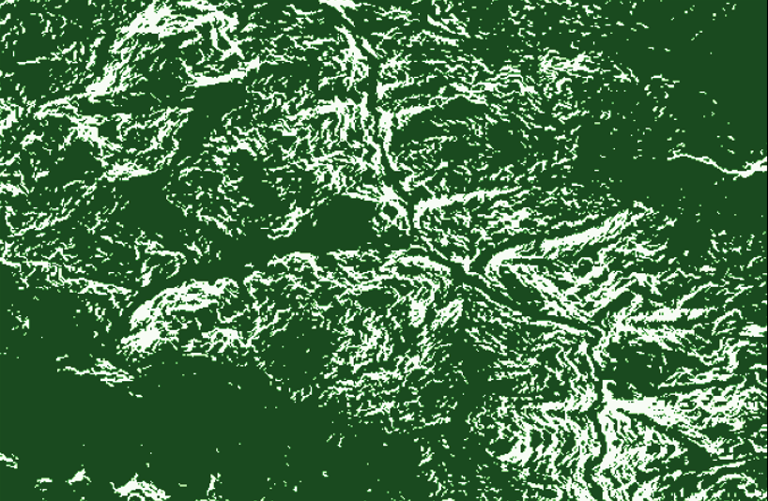
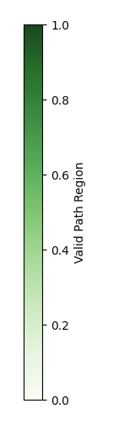
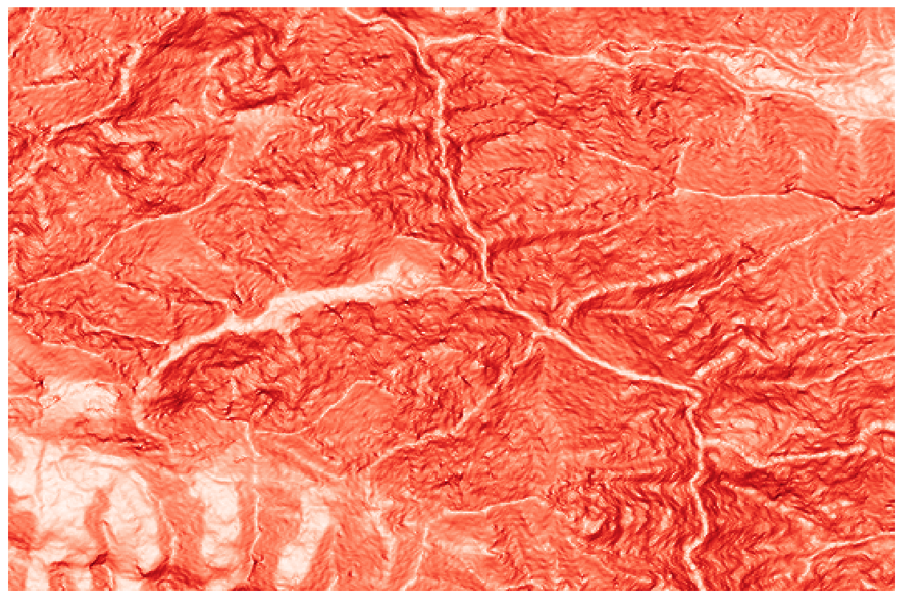
A* PROBLEM RECTIFICATION
DEM-Based Path Planning GUI Using Elevation and Slope-Constrained Subpixel A* Search
Cost Map Generation
1. Data Inputs
DEM and Slope Raster Input: The GUI accepts two GeoTIFF inputs:
1. DEM: Elevation data
GO Area and Valid Mask: Based on user-defined elevation bounds [min,max][min, max][min,max], two binary masks are created:
self.go_area = (self.dem_data >= self.min_elev) & (self.dem_data <= self.max_elev)
self.valid_mask = self.go_area & (self.slope_data <= 45)
2.Slope Raster: Precomputed terrain slope
Pixels outside the elevation range or with slope > 45° are marked invalid. Final mask valid_mask is used for path expansion (1.0 = valid, 0.0 = blocked).
Green to dark green (1.0) = Navigable White (0.0) = Non-navigable

Slide 20
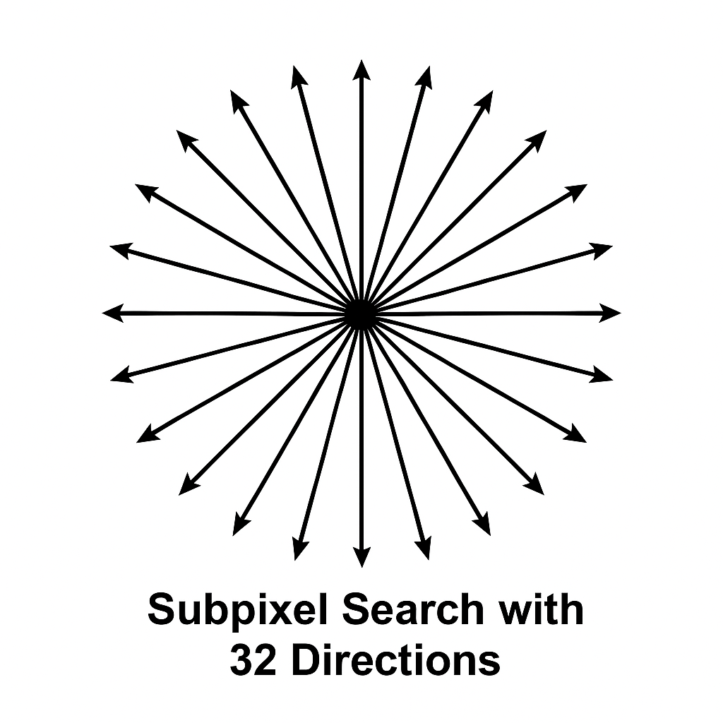
A* PROBLEM RECTIFICATION
DEM-Based Path Planning GUI Using Elevation and Slope-Constrained Subpixel A* Search
A* Pathfinding Logic
A* Pathfinding Logic with Subpixel Precision
1. Start & Goal Selection: User selects start and goal interactively on valid terrain using mouse clicks.
2. Subpixel Search with 32 Directions:
The A* algorithm is extended to support subpixel resolution and smooth path transitions by using 32 angular directions:
directions = [
(np.cos(theta), np.sin(theta))
for theta in np.linspace(0, 2 * np.pi, 32, endpoint=False)
]
A* Core Loop
for dx, dy in directions:
neighbor = (current[0] + dx / substeps, current[1] + dy / substeps)
r, c = int(neighbor[0]), int(neighbor[1])
if 0 <= r < rows and 0 <= c < cols and self.valid_mask[r, c]:
tentative_g = g_score[key] + np.hypot(dx, dy) / substeps
f_score = tentative_g + heuristic(neighbor, goal)
heapq.heappush(open_set, (f_score, neighbor))
For each direction, take a small step (dx/substeps, dy/substeps).
If this step doesn't get us closer to the goal, skip it (gradient descent behavior) .
Converts floating-point neighbor to pixel indices. Only accept points within map bounds and marked as valid in self.valid_mask
g-score: Cumulative travel cost (Euclidean distance between steps)
Heuristic: Euclidean distance between two floating-points

Slide 21
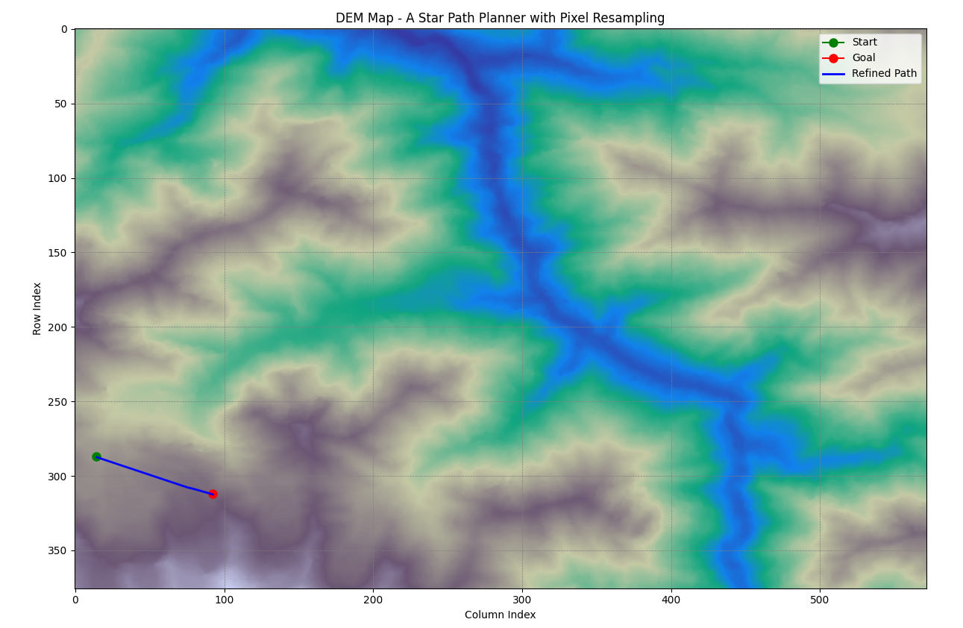
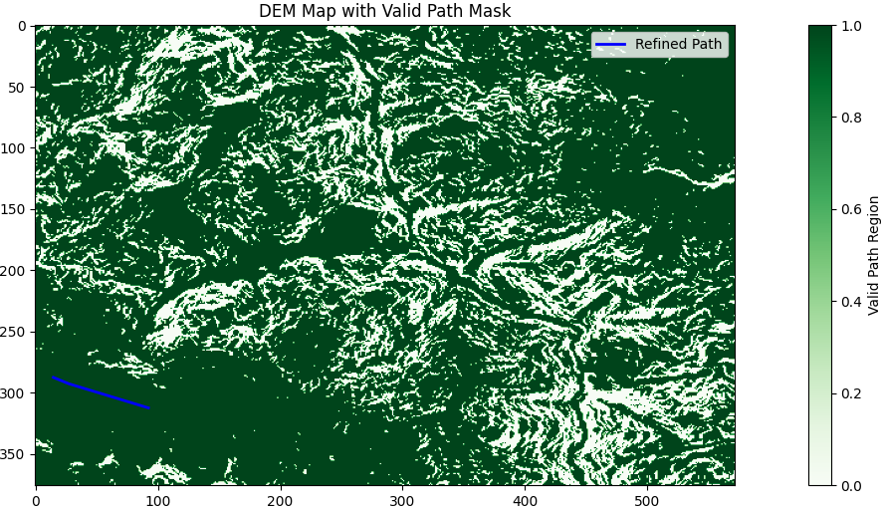
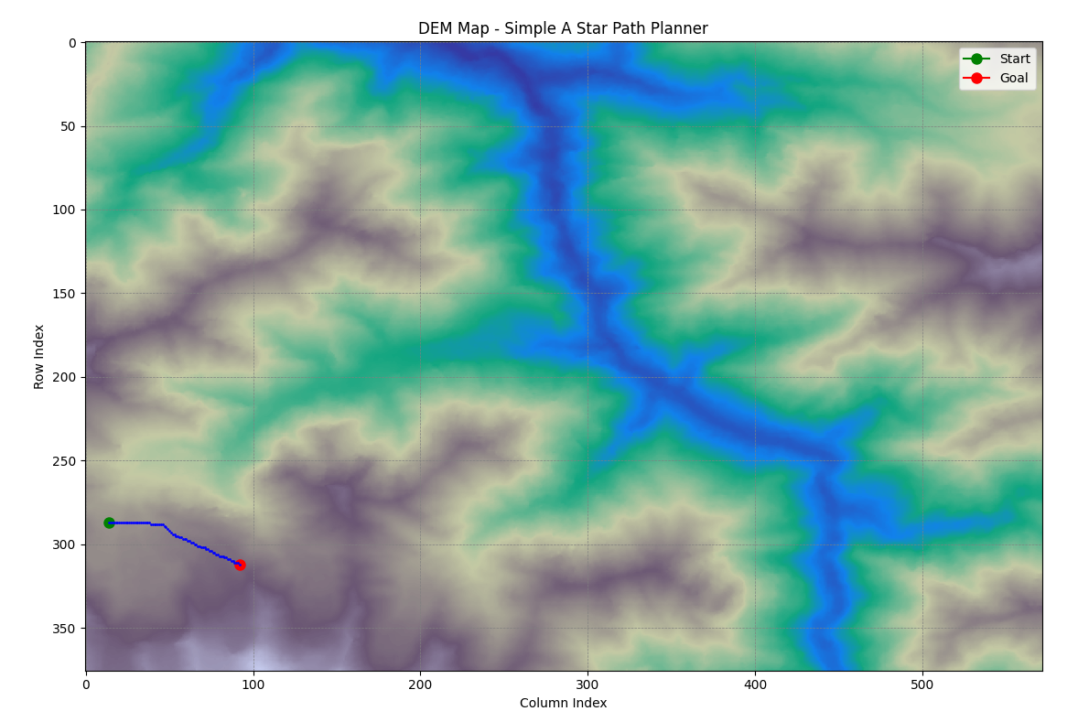
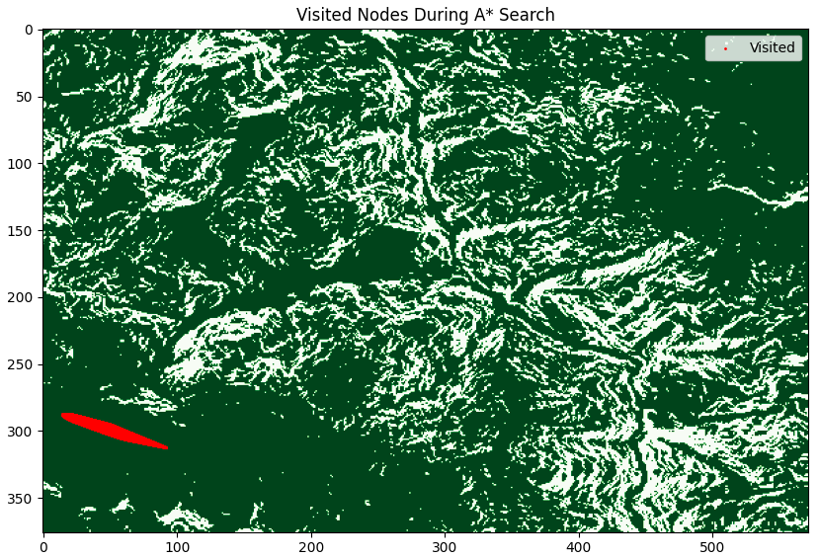
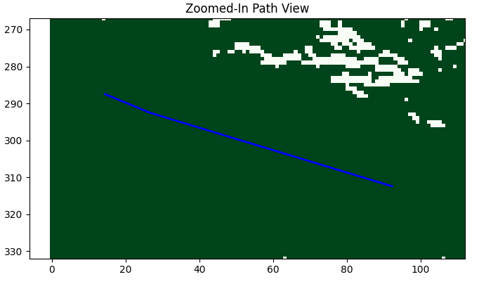
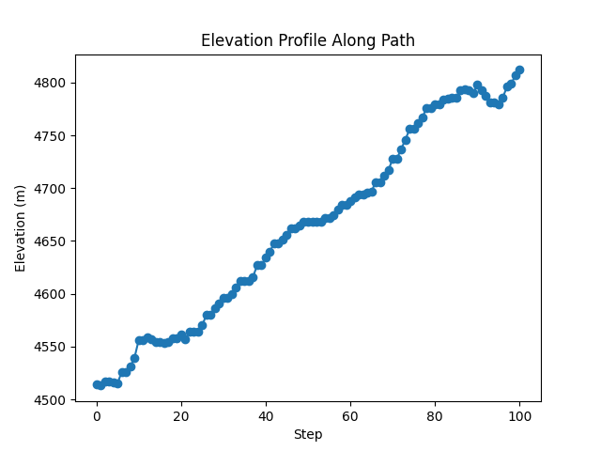
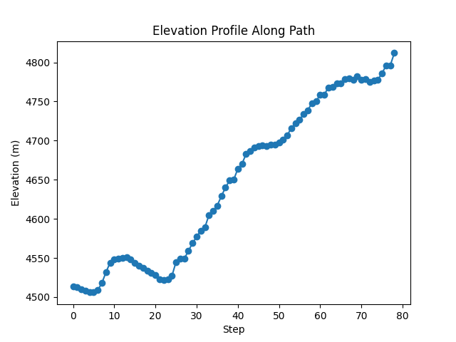
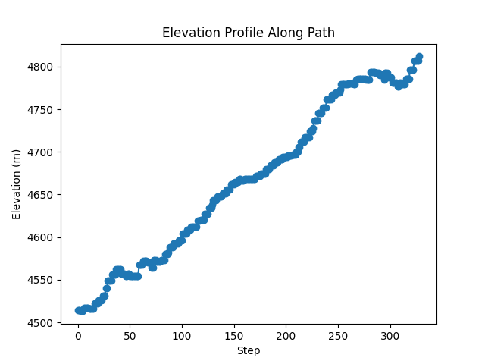
A* PROBLEM RECTIFICATION
DEM-Based Path Planning GUI Using Elevation and Slope-Constrained Subpixel A* Search
Test 1 Output
Start set at: (287, 14)
Goal set at: (312, 92)
A Star with Pixel Resampling
A Star with Pixel Resampling with Constraints
Simple A Star

Slide 22
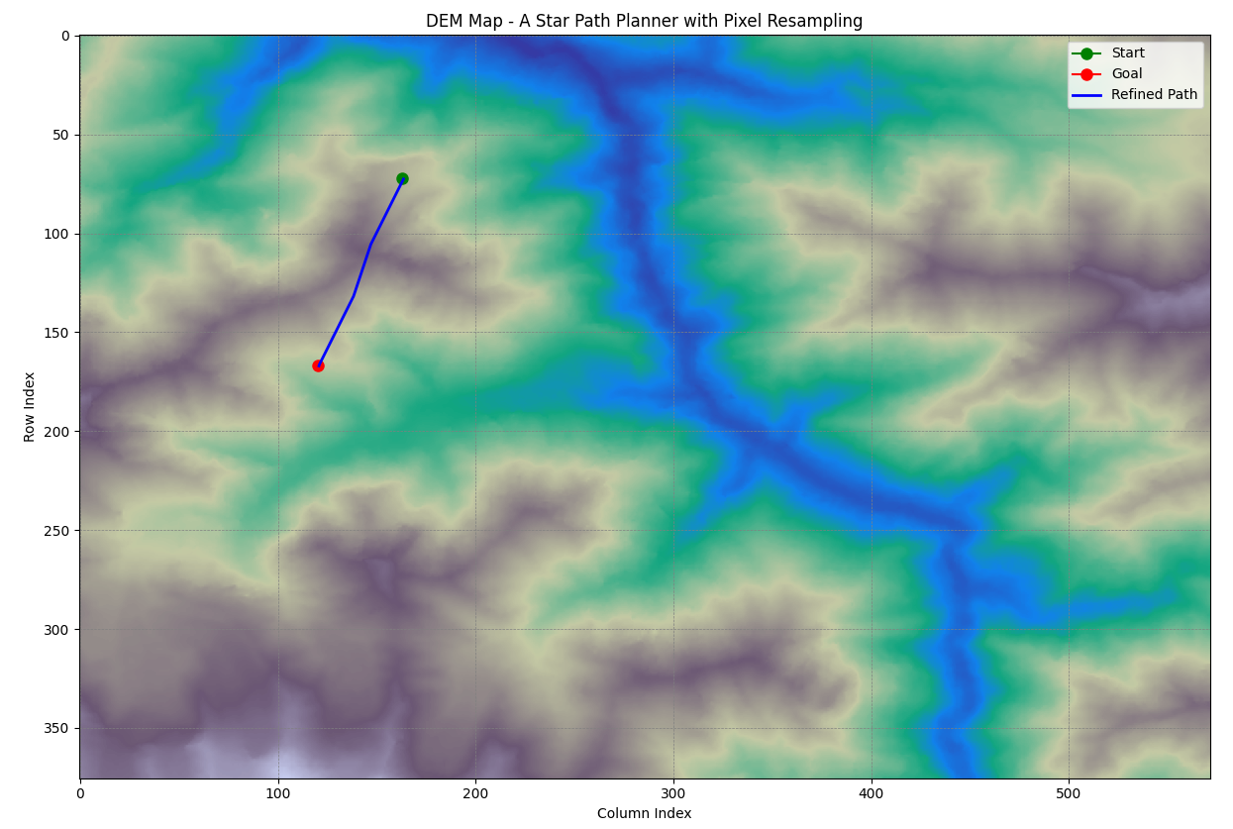
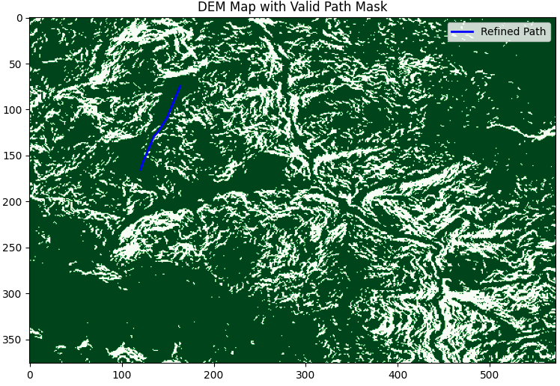
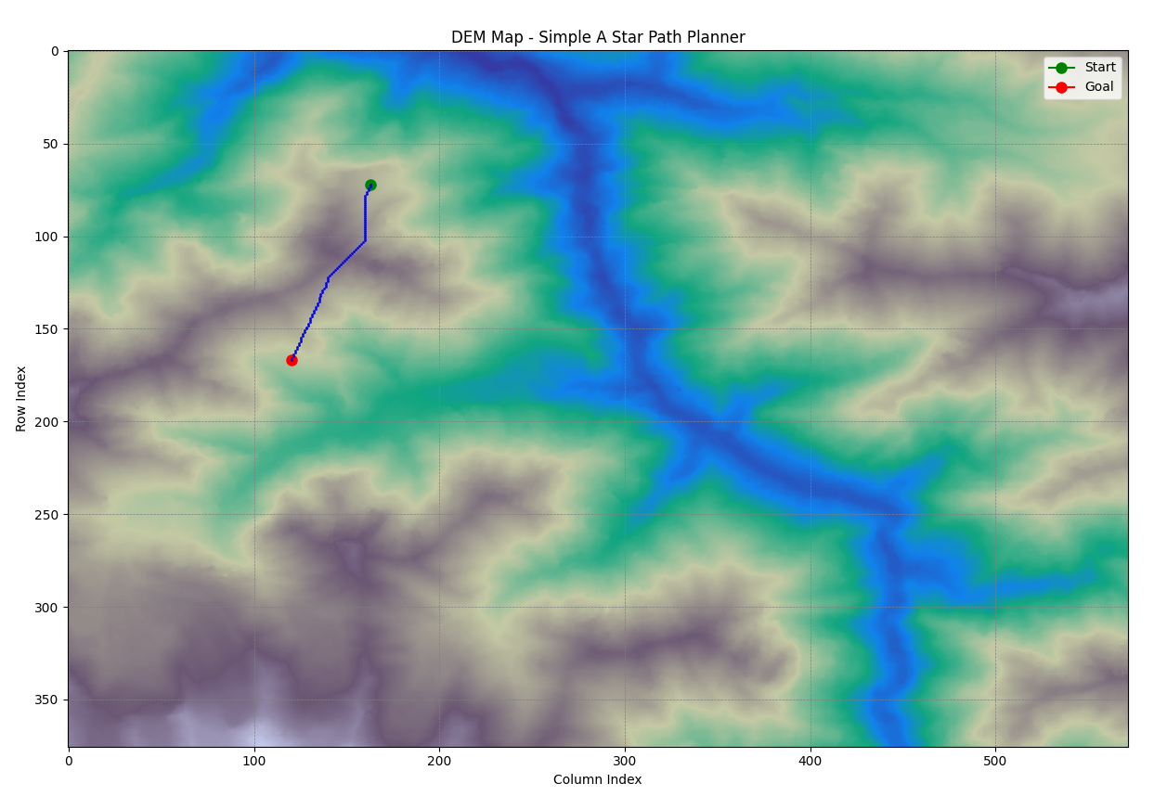
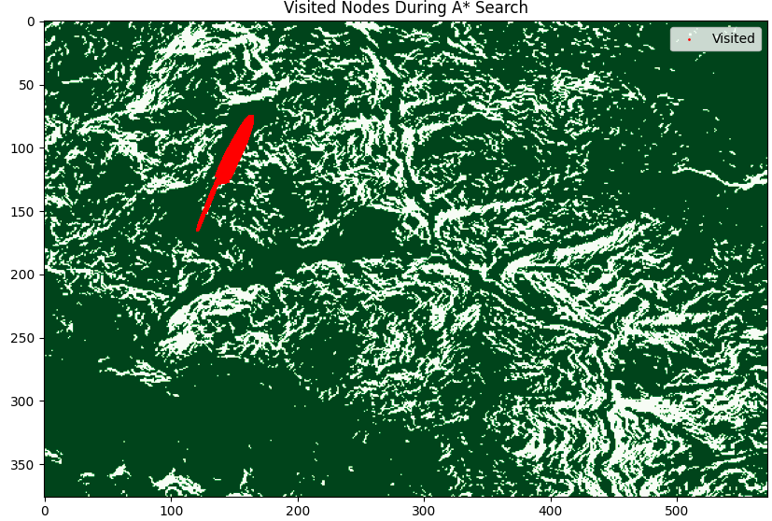
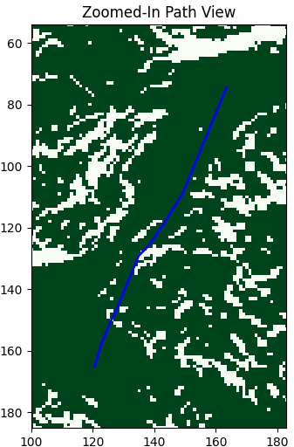
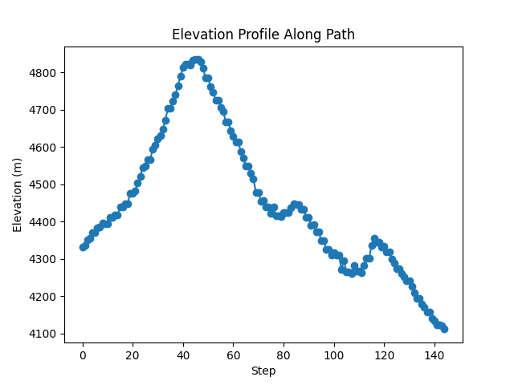
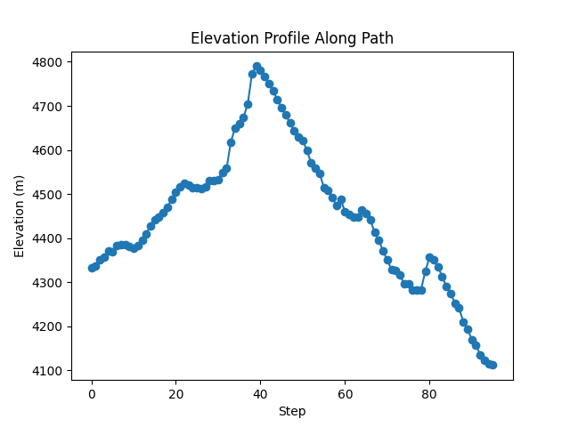

A* PROBLEM RECTIFICATION
DEM-Based Path Planning GUI Using Elevation and Slope-Constrained Subpixel A* Search
Test 2 Output
Start set at: (72, 163)
Goal set at: (167, 120
A Star with Pixel Resampling
A Star with Pixel Resampling with Constraints
Simple A Star

Slide 23


Blue for low-slope segments (≤ 15°)
Orange for moderate slope (15° to 45°)
Red for higher slopes (if allowed)

Slide 24
REFERENCES
S. Khan, S. K. Singh, M. V. R. Prasad, and B. Singh, “Modelling Permafrost Distribution in Western Himalaya Using Remote Sensing and Field Observations,” Remote Sensing, vol. 13, no. 1, pp. 1–24, 2021.
Y. Luo, X. Zhao, L. Zou, Z. Nan, and Q. Zhao, “PIC v1.3: Comprehensive R Package for Computing Permafrost Indices with Daily Weather Observations and Atmospheric Forcing over the Qinghai–Tibet Plateau,” Geoscientific Model Development, vol. 14, pp. 1169–1184, 2021.
D. Guo, H. Wang, and D. Li, “Variations in Growing-Season NDVI and Its Response to Permafrost Degradation in Northeast China,” The Cryosphere, vol. 11, pp. 81–95, 2017.
J. Obu, S. Westermann, A. Kääb, and A. Bartsch, "Permafrost Extent and Ground Temperature Map, 2000-2016, Northern Hemisphere Permafrost," Alfred Wegener Institute (AWI), 2019. Available: https://apgc.awi.de/dataset/pex.
M. Antikainen, “Developing Methods for GIS-Based Terrain Path Planning,” ISPRS Annals of the Photogrammetry, Remote Sensing and Spatial Information Sciences, vol. IV-4/W4, pp. 27– 34, 2017.

